Slide 1


Artificial Intelligence,
Human Error
Thinking critically about machine learning
Oakleigh Wilson | PhD Candidate
University of the Sunshine Coast | Biomechanics and Biorobotics Lab
Notes:
Good morning, my name is Oak and I am a PhD student at University of the Sunshine Coast undertaking research on standardising machine learning approaches for a particular type of ecology research that I'll explain a bit later. When taylor invited me to talk about Ml with you, I was a bit worried because I'm far from being any kind of ML expert... I'm an ecologist who happens to use ML, who happens to be figuring it out bit by bit . Therefore, I'll be giving this talk on my speciality in AI -- all the ways not to use it.

Slide 2






Slide 3
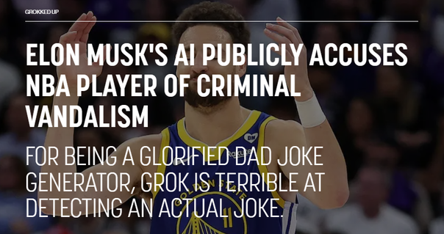
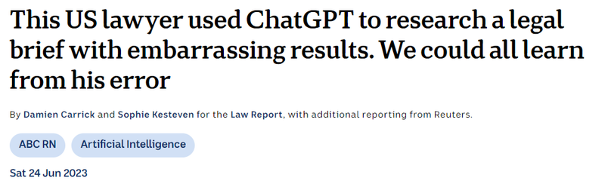

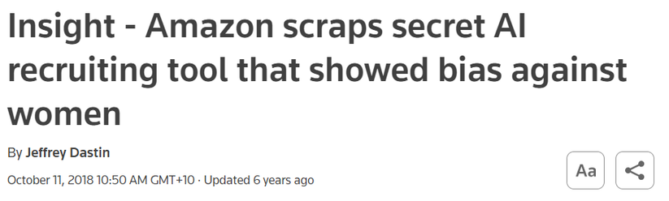


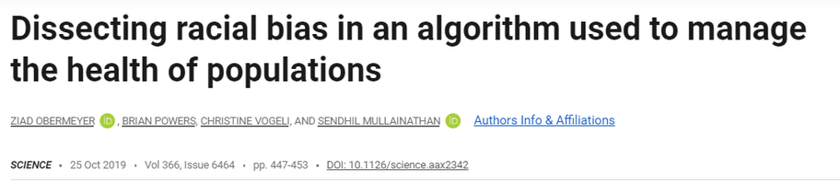
Notes:
AI is dangerous.
I dont mean in the sense of pop culture.
Not in the sense that its going to declare war on us, or we'll fall in love and abandon normal socialisation, or even that it is going to replace humans across every industry... While all of these may well be true - I mean in a much less hollywood way... In the subtle sense of overconfidence and blind trust.
This can be harmless or funny, like AI misunderstanding humour as truth, but it can also be very detrimental when professionals and workplaces automate their decision making, mistaking hallucinations for reality, and embedding deep biases - against women, against racial minorities, against the already discriminated - hardbaked into their decision making.
This is not the fault of the AI. It did what it was trained to do. It is the fault of the humans at the helm. I am wary of AI not because it is better than human, but because it's created, implemented, and interpreted by humans. I am nervous of AI because it is extremely fallible to human error, but treated as if it is not.

Slide 4
AI POWERED!
What is the use case?
How was it trained?
How was it tested?

Slide 5
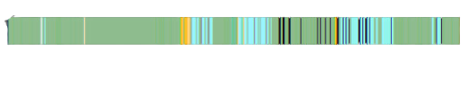
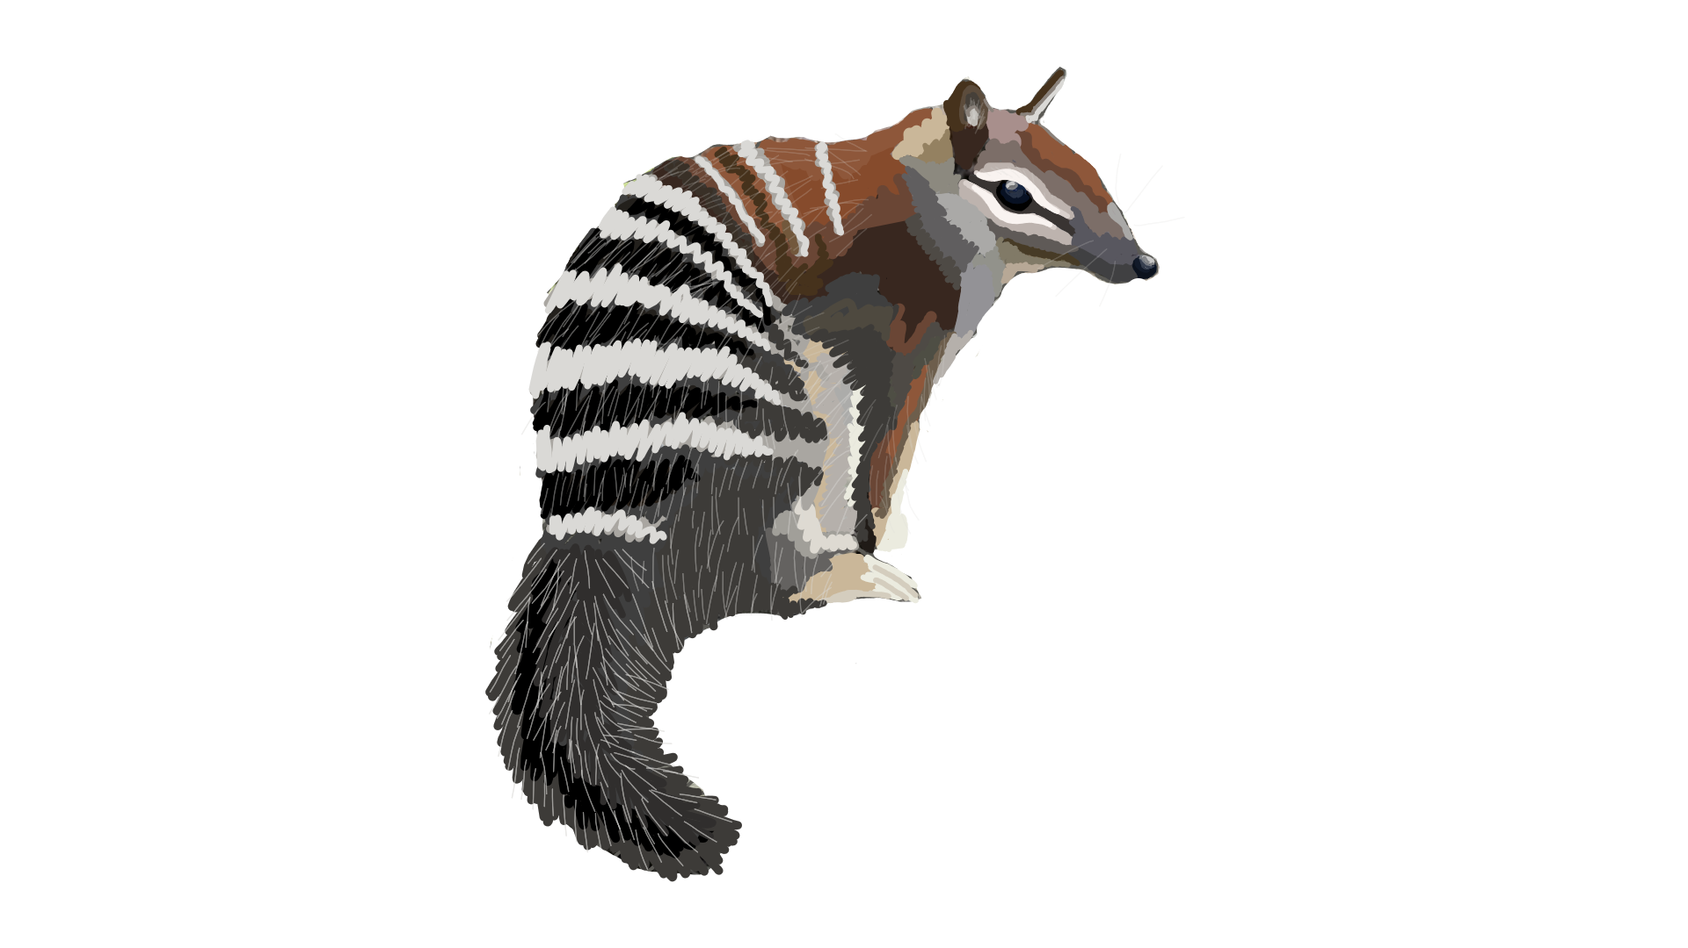
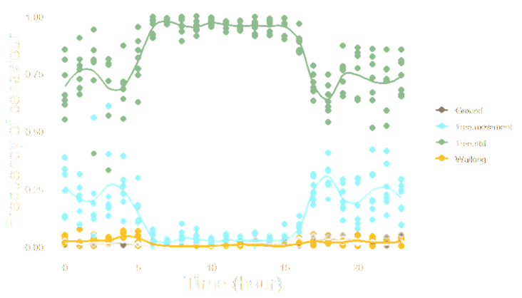
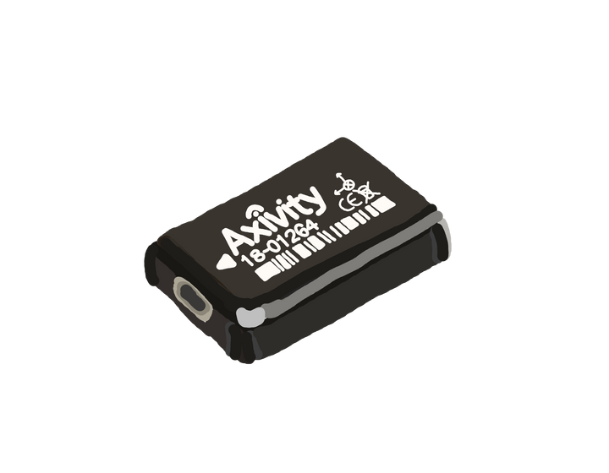
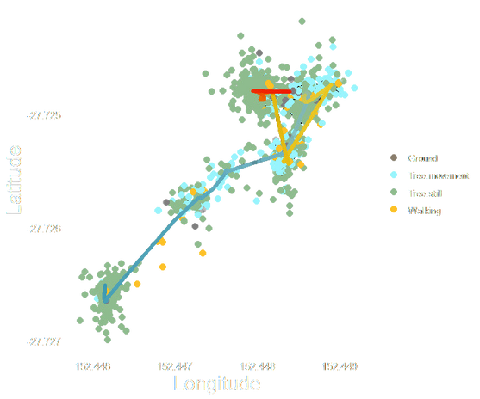
Ground
Tree Move
Walk
Tree Still

Slide 6
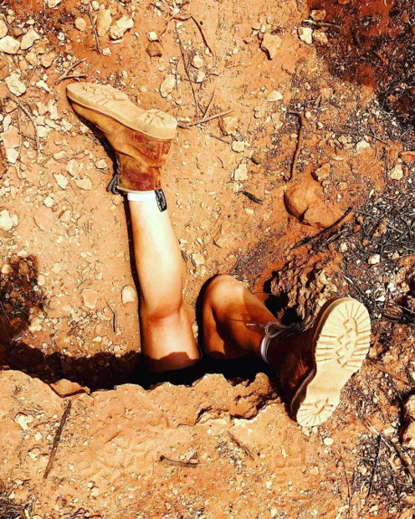
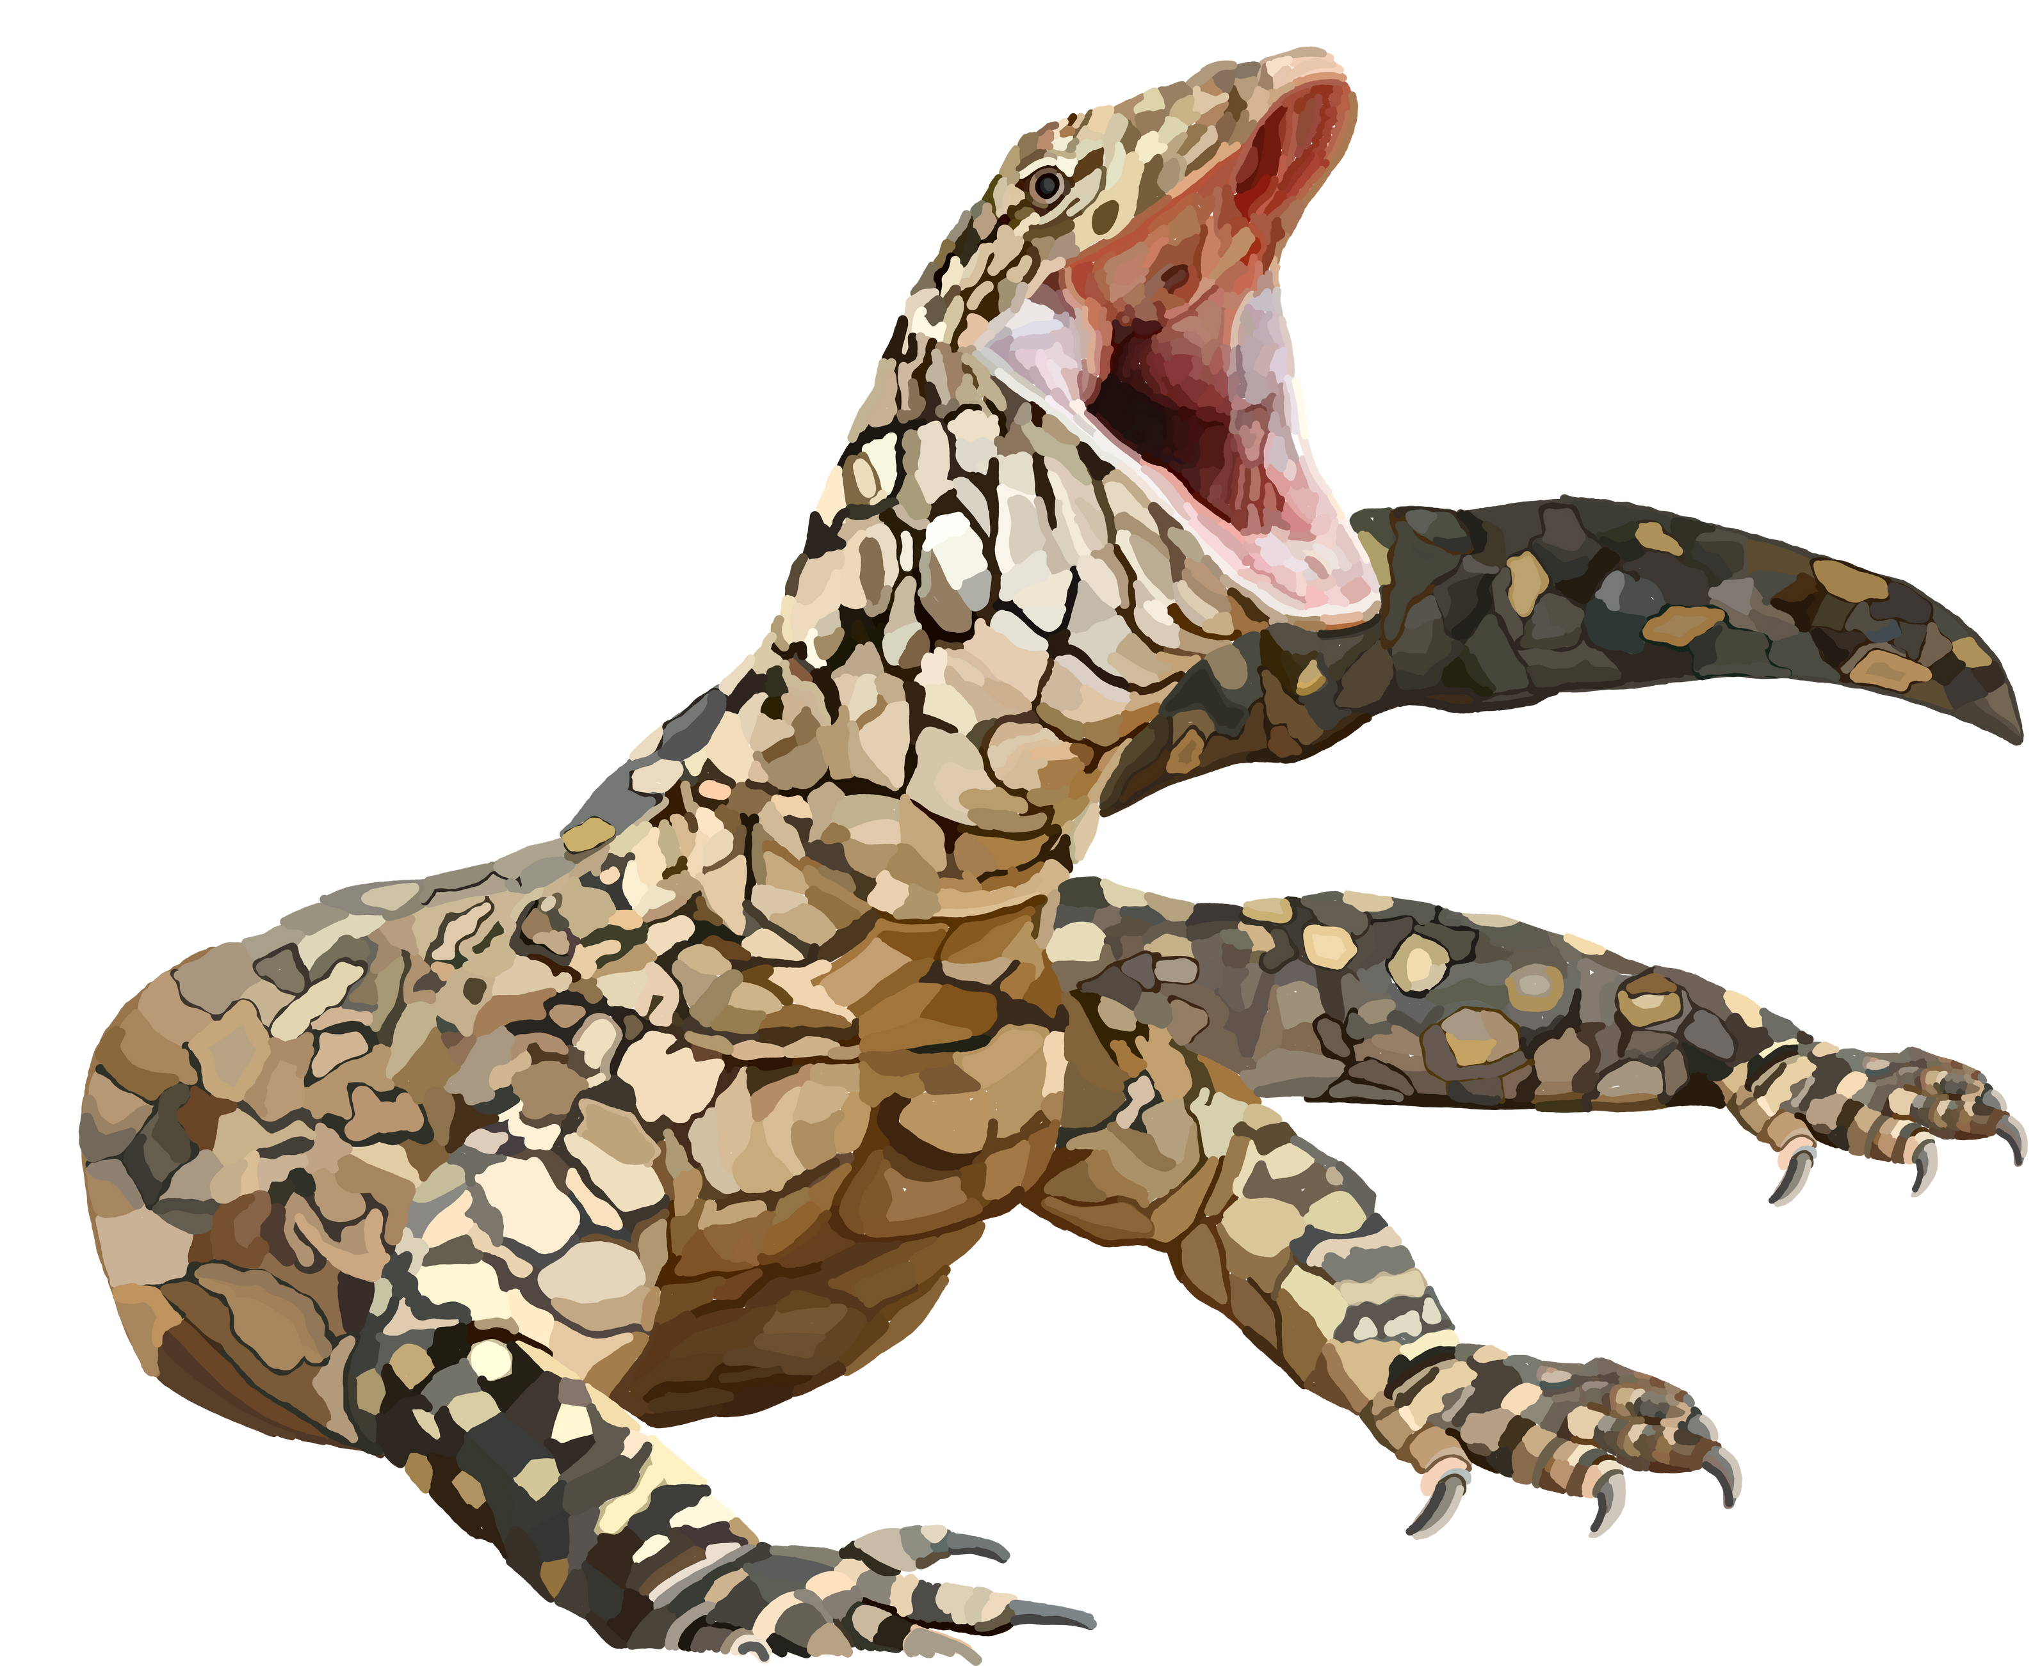
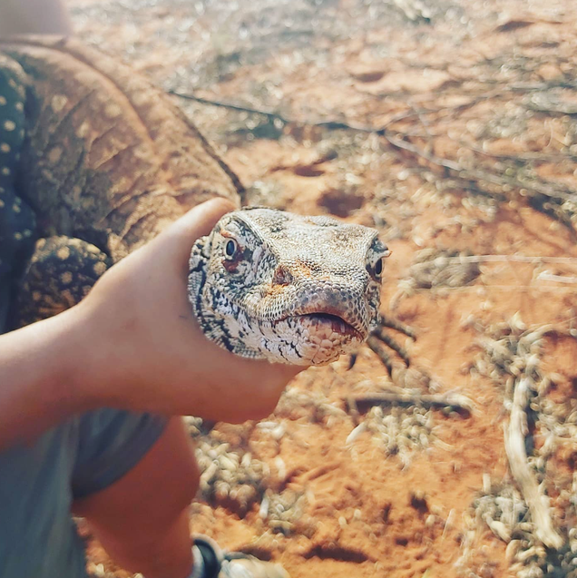
1.5 years
3 trips to the NT
30kms hiking per day
>40 degree temps
Josh got heat stroke
2 collars retrieved
8 behaviours
Fragments of each
Notes:
For this section, I want to introduce you to the perentie lizard.
Explain.
99% accurate? Does that seem right? There were barely any individuals, a lot of behaviours, and very little was retrieved. Can we really say we understand the perentie?
No. So what’s going wrong here. Why is it saying that it can? Critical thinking is needed.

Slide 7


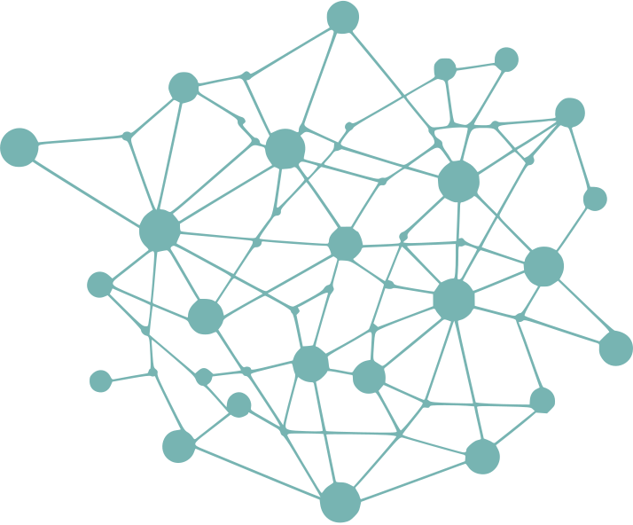




Questions
Data
Model
Verification
Notes:
Machine learning is made up of four major steps. There is the data that goes in, the model, the verification of that model, and the questions you ask while doing all of this. While this middle one is far and above what gets the most attention, I want to use this talk to draw your attention to these other elements.
A machine learning architecture is just a bunch of nodes and logic gates and micro decisions, some of which are faster/larger/more complex than others but ultimately they are just statistical processes.
They are only as good as the questions they are asked, the data they are built on, and the verification applied.
To understand what went wrong with out lizards we need to take a step back

Slide 8

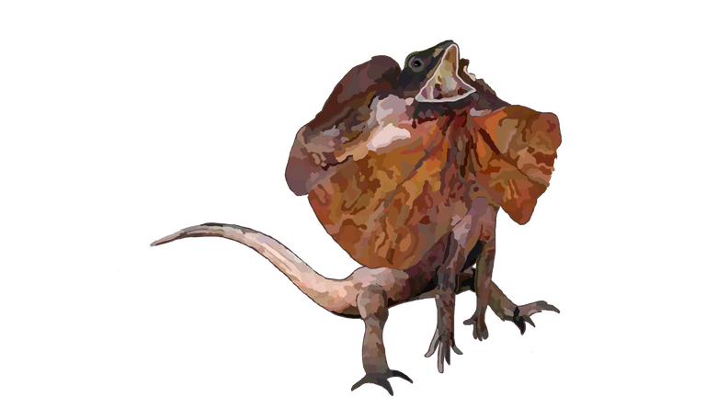



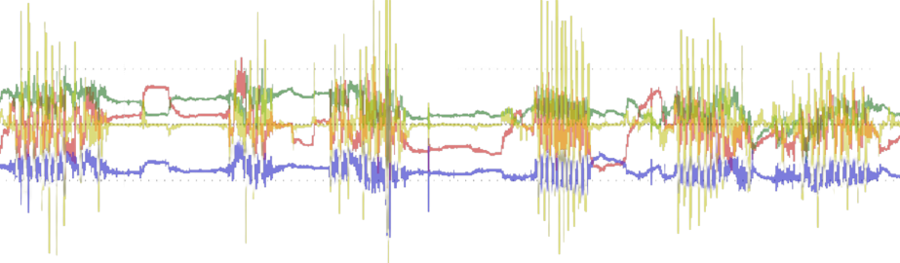



BUILD TRAINING DATASET
A B A C B B
(large neural networks create their own features)
window
min
mean
max
skew
FFT
min
mean
max
skew
FFT
min
mean
max
skew
FFT
(simple models take in features)
features

Slide 9


min
mean
max
skew
FFT
Notes:
The oldest adage in the machine learning books is rubbish in, rubbish out. A machine learning model is only a series of things that are done to data. Generally, for the kind of ML we're dealing with, the model is only as good as the data it is fed.
For Ml to work, the features have to be good representations of the data and the data has to be a good representation of the problem (where the problem is all data from which our data is a subset)

Slide 10
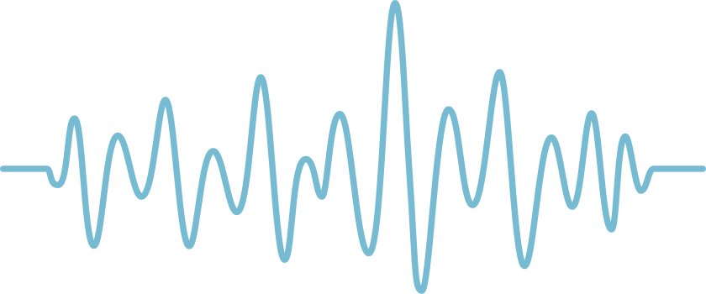
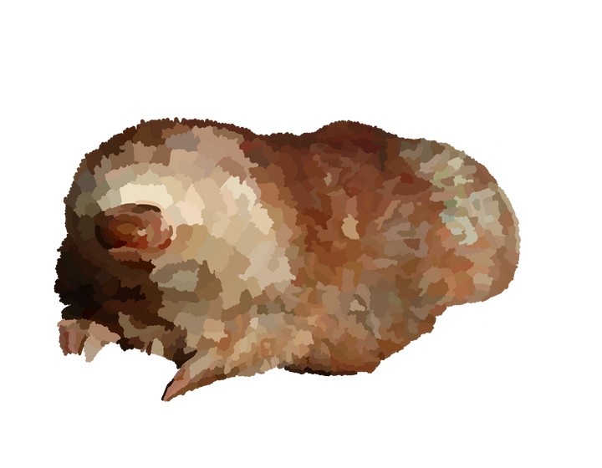









Validating
data
Training
Testing
1 x
1 x
1 x
FEEDING
SITTING
WALKING
?
True
data
Labelled data
SITTING
SITTING
SITTING

Slide 11
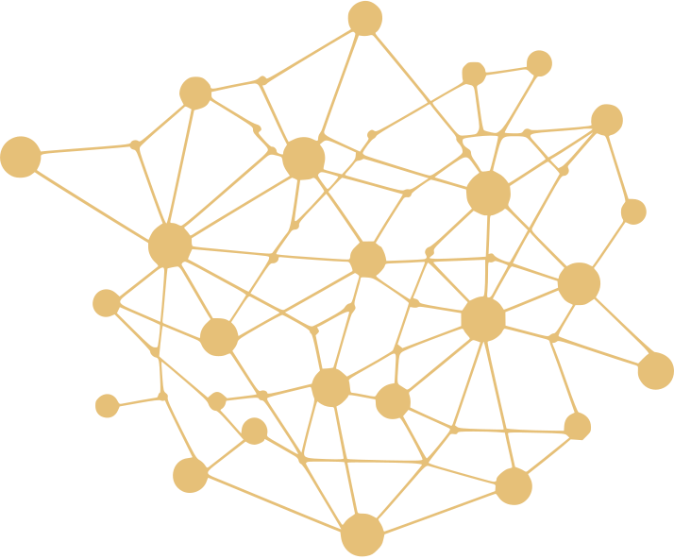



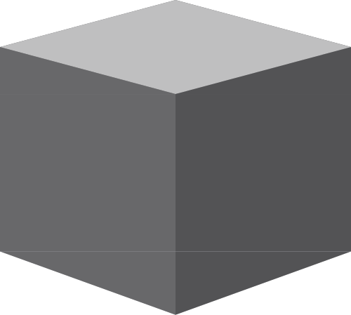
BUILD TRAINING DATASET
A B A C B B
TRAIN A MODEL
A B A C B B

Slide 12




















Slide 13




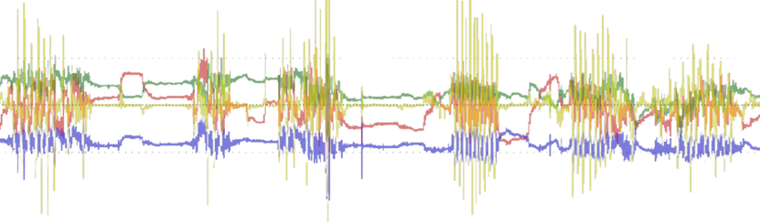

1203
1311
3002

Slide 14
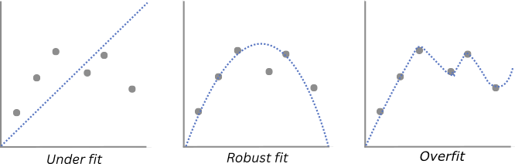
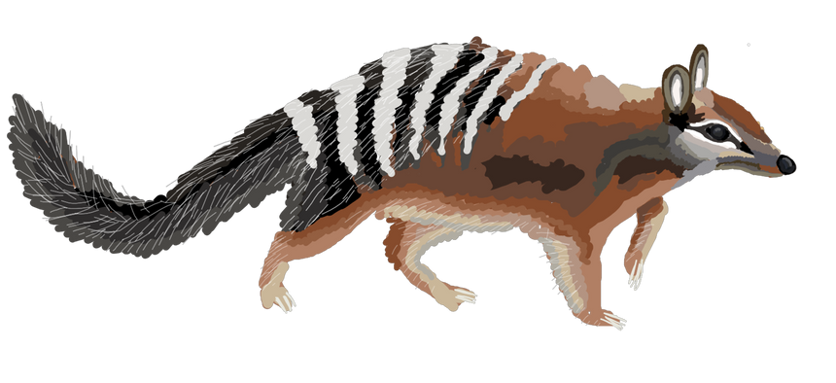
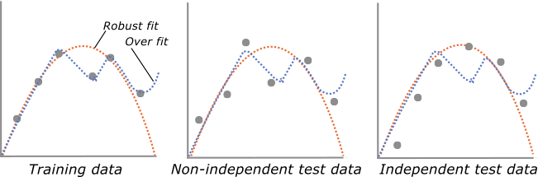
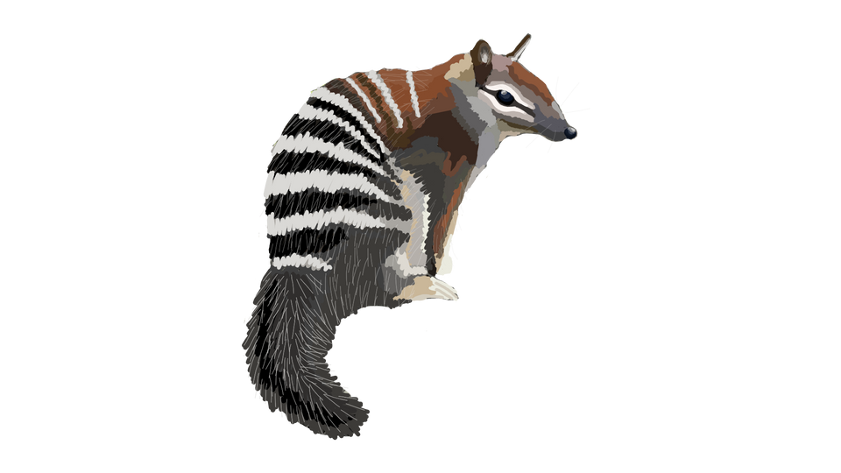
Overfit to the training set
Does not generalise to new data
Notes:
Overfitting is the curse of machine learning.

Slide 15






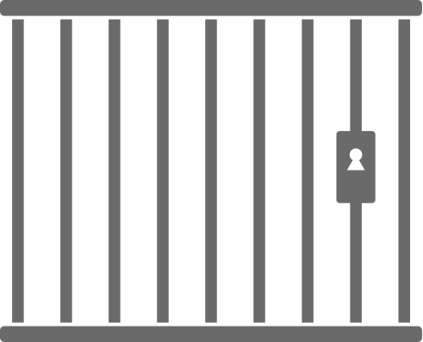
deployment performance is unknown
model predicts onto the deployment data
deployment data is unknown
use ground truth data to
build a model
ground truth data is known
use ground truth data to
validate the model
Notes:
We have some ground truthed data (where we know what categories the data is) and we use it to build a model we which deploy onto unknown data.
We want to know how good the model will be when we deploy it, but we but we don't know because we don't know what the data is.
Instead we have to approximate it by looking at the performance on the data we do know, the ground truth data . But we trained on that data, so the model already knows the answers. Testing on the training data would be useless because we would get really high performance and still not know how it performs on the deployment data.
Instead, we split out data.

Slide 16
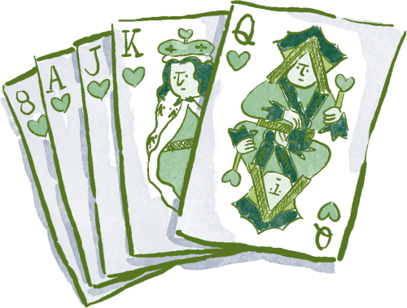




random stratified
time stratified
individual stratified
1 2 3 4 5 6 7 8 9
Training
Validating
Testing
Notes:
Instead we split our data in multiple portions, some used for training, others for testing.
We can do this multiple ways and far from trivial, the way you decide to split your data has massive influence on what your data can tell you.

Slide 17
original data
windowed data
random stratified
training data
testing data
original data
training data
test data
Unnaturally similar

Slide 18
windowed data
time stratified
training data
testing data
1 2 3 4 5 6 7 8 9
Appropriately different

Slide 19
ind 1
ind 2
ind 3
ind 4
ind 5
individual stratified
Independent provided there is no close relation between the individuals
training data
testing data

Slide 20
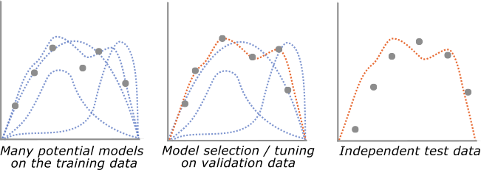

Slide 21

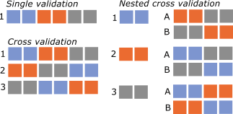
Testing
Notes:
In an an deal world the test data would be kept in a blind lock box not even seen until you're publishing your model. This sounds like a conspiracy but you - the researcher - your brain forms part of the ML system and if you look at the test data, become familiar with it, overfitting is likely to happen.

Slide 22
Ground truthed
Accuracy = TP + TN
SUM(all)
= 11 + 0
11+1+0+0
data
Pos
Neg
Pos
TP
FP
Precision = TP
TP + FP
Predicted
Neg
FN
TN
Recall = TP
TP + FN
Ground truthed
Specificity= TN
TN + FP
Pos
Neg
Pos
11
1
F1 = 2 x precision x recall
precision + recall
model
=
Predicted
MCC = TP * TN - FP * FN
(TP + FP) * (TP + FN) * (TN + FP) * (TN + FN)
Neg
0
0
91% accurate
Notes:
The next decision is choosing what metrics to measure performance with. Remember how I said most papers in my field were reporting 90-99% accuracy. Already I've shown how that was likely an overestimating due to incomplete validation, but accuracy itself can be misleading too.
Here is some data, its mostly blue, a little yellow. Imagine, that the blue are normal samples and yellow indicates an important abnormality we want to study. Lets create a simple model.
Okay, this model sucks. It says, if data, then blue. It's terrible, it predicts all incoming samples to be blue without detecting yellow at all.
Technically, however, it's over 90% accurate. Publish that!

Slide 23
BUILD TRAINING DATASET
A B A C B B
TRAIN A MODEL
A B A C B B
DEPLOY MODEL
A B A C B B
Notes:
And only now, only after all of that are you ready to deploy your model. And it must be deployed on individuals who fall within the correct scope.

Slide 24
Too few individuals
Too many behaviours
Non-representative data (climbing in an enclosure =/= climbing in the wild)
Randomly divided consecutive sequences
Tuned model without a validation set
Very overfit, non-generalising model (i.e., definitely not 99%)

Slide 25
Do you have enough :
data total?
data per class?
classes per individual?
Is the data of high quality?
Can patterns be visually distiguished?
Is it sufficient to represent the real problem?
How can we validate this model?
What counts as an independent sample?
Does this model need to generalise a lot or a little?
How many different variants am I going to try?
Can I simplify the question?

Slide 26
confusing data and questions
high-tech models
confusing results
?!??#%*!?}??&$!@#&?!\??/
!!!?%^&{if}!&*
!!#@{else}*&!!
simple data and questions
simple models
simpler results
?
!

Slide 27
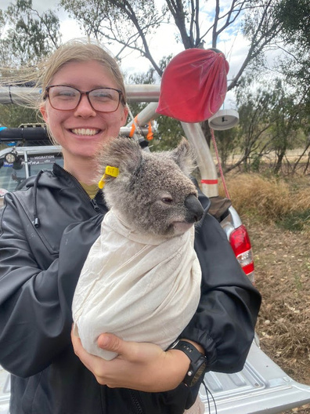
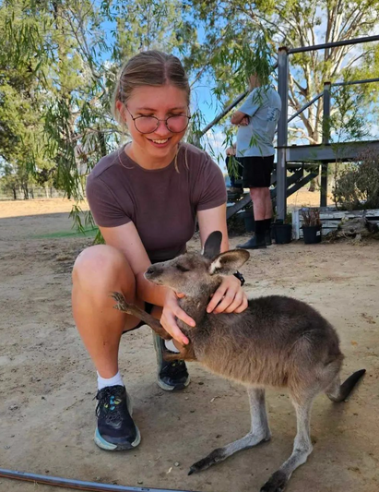


Thank you
oakalice.github.io

